Slide 1
Homework 1

Slide 2
Homework 1
Subject :
Data Preprocessing
Description
The raw data are often loosely controlled, resulting in out-of-range values, missing values, etc. The data preprocessing is an important step in the data mining process to quality of data. In this homework, you need to use R programming language to implement this process.
Data:
The data of air quality from EPA
http://taqm.epa.gov.tw/taqm/tw/default.aspx

Slide 3
Homework 1
Step 1: Filter noise (abnormal) data
E.g : out-of-range value

Slide 4



Homework 1
Step 2. Fulfill missing value
Use linear interpolation
Linear interpolation is one of the technique to deal with missing values.
linear interpolation takes two data points, say (x_{a},y_{a}) and (x_{b},y_{b}), and the interpolant is given by

Slide 5
Homework 1
Air Quality Index (AQI)
Taiwan
The index is based on the concentrations of 6 pollutants. The index is calculated from the concentrations of the following pollutants: O3, PM2.5, PM10, CO, SO2andNO2. The breakpoints between index values are defined for each pollutant separately and the overall index is defined as the maximum value of the index. Different averaging periods are used for different pollutants.
Ref: https://taqm.epa.gov.tw/taqm/tw/b0201.aspx

Slide 6

Homework 1
actual
data
AQI
AQI | O₃ (ppm) 8 hours mean | O₃ (ppm) 1 hour mean | PM_{2.5} (μg/m³ ) 24 hours mean | PM₁₀ (μg/m³ ) 24 hours mean | CO (ppm) 8 hours mean | SO₂ (ppb) 1 hour mean | NO₂ (ppb) 1 hour mean
0～50 | 0.000 - 0.054 | - | 0.0 - 15.4 | 0 - 54 | 0 - 4.4 | 0 - 35 | 0 - 53
51～100 | 0.055 - 0.070 | - | 15.5 - 35.4 | 55 - 125 | 4.5 - 9.4 | 36 - 75 | 54 - 100
101～150 | 0.071 - 0.085 | 0.125 - 0.164 | 35.5 - 54.4 | 126 - 254 | 9.5 - 12.4 | 76 - 185 | 101 - 360
151～200 | 0.086 - 0.105 | 0.165 - 0.204 | 54.5 - 150.4 | 255 - 354 | 12.5 - 15.4 | 186 – 304 | 361 - 649
201～300 | 0.106 - 0.200 | 0.205 - 0.404 | 150.5 - 250.4 | 355 - 424 | 15.5 - 30.4 | 305 – 604 | 650 - 1249
301～400 | ⁽²⁾ | 0.405 - 0.504 | 250.5 - 350.4 | 425 - 504 | 30.5 - 40.4 | 605 – 804 | 1250 - 1649
401～500 | ⁽²⁾ | 0.505 - 0.604 | 350.5 - 500.4 | 505 - 604 | 40.5 - 50.4 | 805 – 1004 | 1650 - 2049

Slide 7
Homework 1
Score
1. Filter Noise data 10%
2. Fulfill missing value 15%
Please consider all possible cases
E.g : Cross-day
3. Calculate AQI of every hour (2nd day). 75%
Each air pollutants (O3(8hour), O3(1hour), PM2.5, PM10, CO, SO2 and NO2) 70% (IAQIp)
Find the maximum value of the index 5% (AQI)

Slide 8
Homework 1
Input :
A csv file (input.csv)
The data of air quality from EPA
Output:
The AQI and IAQIp of every hour.
Format : Date, Hour, AQI, O3(8hour), O3(1hour), PM2.5, PM10, CO, SO2, NO2
save as csv file (output.csv)

Slide 9
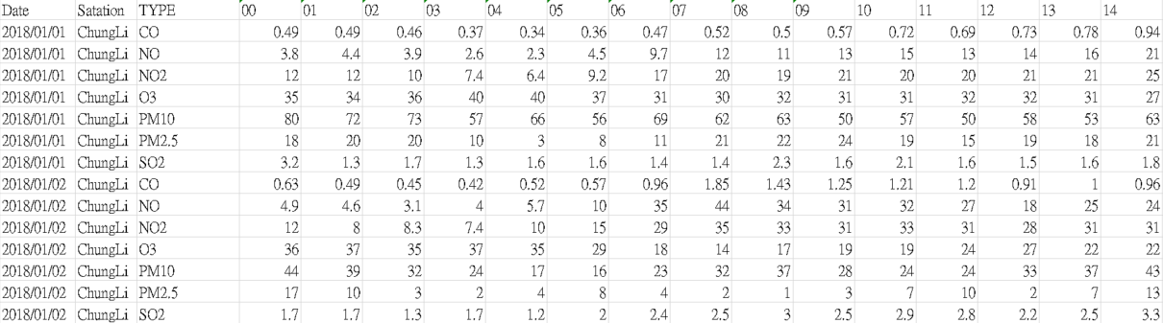
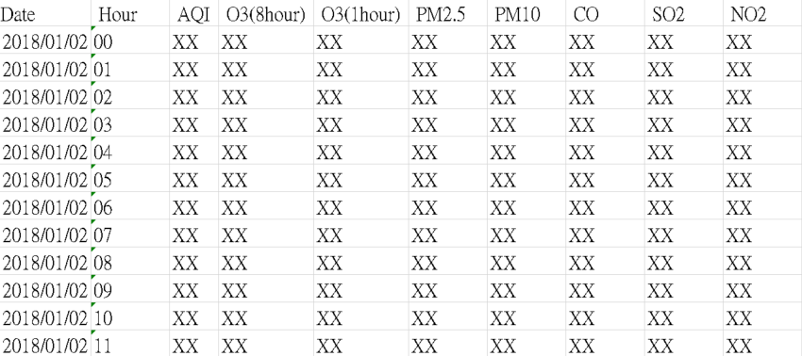
Homework 1
Example:
input
…
output

Slide 10
Deadline
Deadline
2019/04/12 23:59
Submit
Portal
Filename
s+SID_HW1.r
e.g : s1001234_HW1.r

Slide 11
Bonus
Bonus 1 : Top 10% submit
Note : Score > 90
Bonus 2 : Provide Data
mailto: tinin@saturn.yzu.edu.tw

